Slide 2
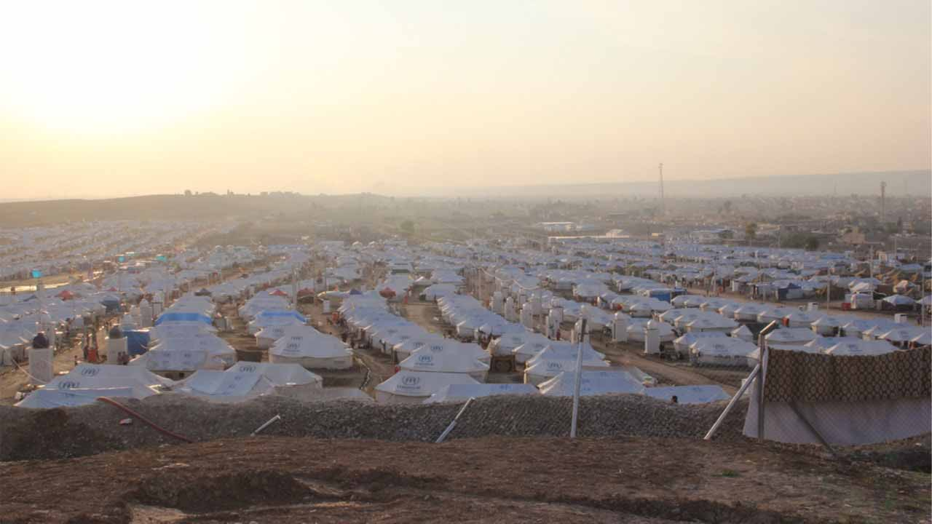
Iraq & Syria
The Islamic State is seeking the eradication of all non-Muslim and non-jihadist minorities in Iraq.
Iraqi Christians face a terrible ultimatum: convert, pay the strenuous Islamic tax, or die.
Many Syrian Christians have also been chased from their homes and communities.
Notes:
In Iraq and Syria, the Islamic State (also known as ISIS) is a fundamentalist Islamic group that does not even see the Al Qaeda as extreme enough.
Their goal is to establish an Islamic caliphate(government) and eradicate all non-Muslim minorities in the area.
They have destroyed government departments, released prisoners, and killed countless thousands.
[click]
Christians in Mosul Iraq were issued an ultimatum, “Convert, pay the jizya Islamic tax, or be killed.” Now, the city has been emptied of all Christian presence. Thousands have been displaced from their homes.
[click]
The Islamic State’s influence stretch beyond Iraq’s borders into the already war-torn country of Syria. Christians workers there indicate there may be as little as a few thousand Christians remaining in the country. Those still in the country have had to flee their homes to refugee camps.

Slide 3
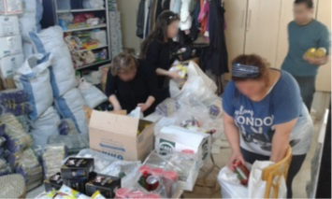
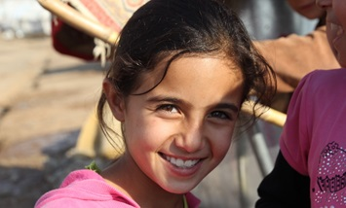
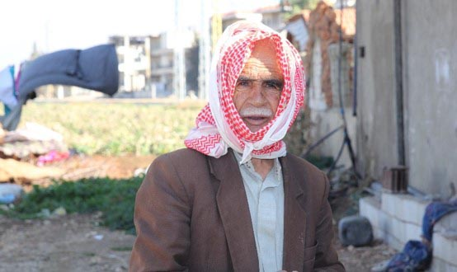
Iraq & Syria
Provision
Encouragement
Revival
Notes:
Please pray for the Christian minorities still present in Iraq and Syria. Pray especially for Christian relief efforts in Syria which, in addition to distributing necessary food and clothing, have also delivered Bibles into the hands of thousands. Specifically pray that as they read the Word of God, they will be greatly encouraged, strengthened and comforted. Pray also for the Christians directing these relief efforts.
[click]
Ask the Holy Spirit to touch the hearts of Christians in both countries in a profound way. In the midst of their struggles, pray that they will remember that they have not been separated from the love of Christ.
[click]
It is reported that many Muslims are in fact turning to Christ in the midst of this huge upheaval. Ask the Lord to raise up spiritual leaders with a burden and desire to disciple new believers.
May the love of Christ lead many, including jihadist Muslims, into His open arms.

Slide 4
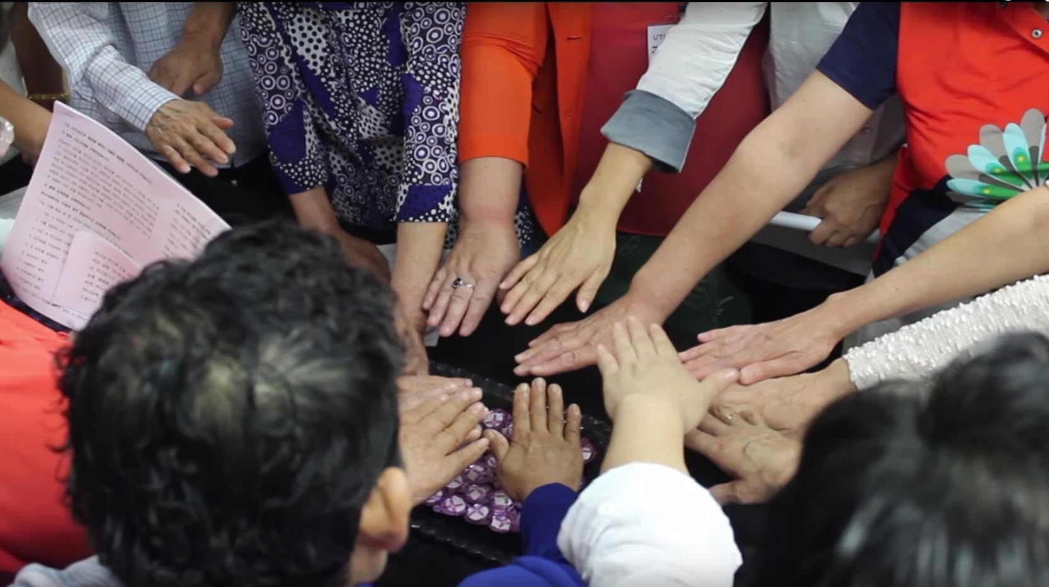
North Korea
North Korea’s regime is the most oppressive in the world, maintaining one of the world’s largest armies.
North Korea is the worst persecutor of Christians in the world. Christians are tortured and murdered.
As many as 100,000 believers are thought to worship in secret.
Notes:
North Korea's isolated regime is the most oppressive in the world. North Korea maintains one of the world's largest standing armies and an expansive system of political prison camps, which hold a significant number of individuals arrested for "illegal"; religious activity.
[click]
North Korea is the worst persecutor of Christians in the world. Christians are tortured, imprisoned and murdered. Private, non-state-sanctioned religious activity is prohibited. Anyone discovered engaging in clandestine religious activity is subject to arrest, torture or even public execution.
[click]
As many as 100,000 believers are thought to worship secretly. Experts estimate that of the hundreds of thousands incarcerated in labour and concentration camps, about 30,000 are Christians. Religious prisoners are typically treated worse than any of the other inmates. Possessing a Bible, saying the words God or Jesus and meeting together are all offenses punishable by death.

Slide 5
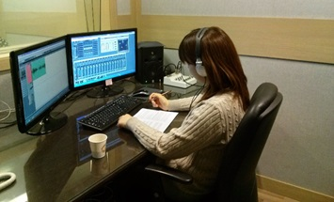
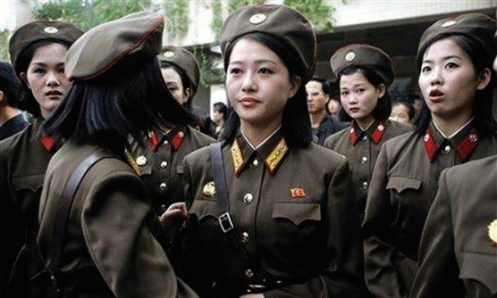
North Korea
Discipleship
Encouragement
Rescue
Notes:
Please pray for North Korean defectors who have dedicated themselves to missions. Pray for protection over their Gospel-sharing efforts, and that others would see the love of Christ in their life and actions. Pray for other defectors who often live in unimaginable darkness even after they have escaped North Korea. Pray for the light of the Gospel to shine in their hearts.
[click]
Pray for the Christian broadcast of gospel content into North Korea. Please pray for the teams that plan and voice these broadcasts every week. Pray that the broadcasts would be an encouragement to North Korean Christians who have not had much training and have not had much encouragement.
[click]
Pray for the North Korean persecutors of Christ’s body. Many are lost and deceived by North Korea’s false religion of Juche which practices worship of the Kim family.. Pray that the persecuted will be able to extend love and kindness to them, but especially pray that dark eyes would see the glory of the Lord and Saviour.

